Slide 1
“Relevant personal quote that captures the persona’s attitude and personality”
Add image that represents this persona
Goals
The related objectives this person wants to successfully complete
Frustrations
The issues or pain points that they encounter or try to avoid
Name
Age:
Education:
Hometown:
Family:
Occupation:
Brief story or scenario that conveys the persona’s user journey, highlighting their goals, frustrations, and other relevant context.

Slide 2
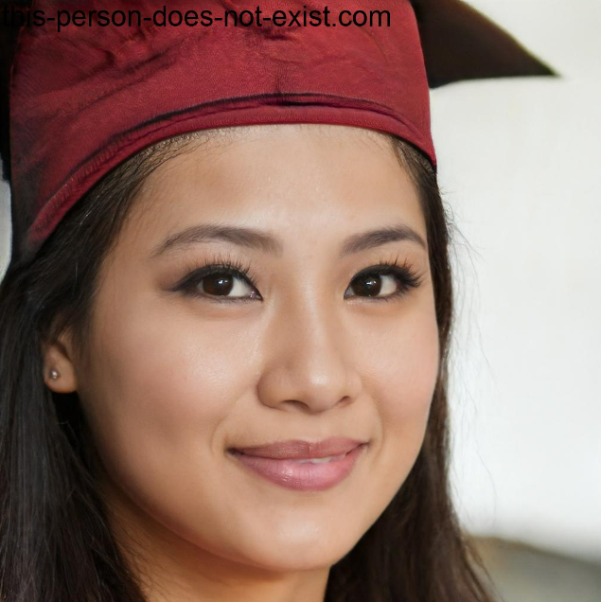
“R”
Goals
T
Frustrations
T
Lei Zicing
Age:
Education:
Hometown:
Family:
Occupation:
26
Master
Hong Kong
Single
Entrepreneur
(Founder & CEO of her design company)
B

Slide 3
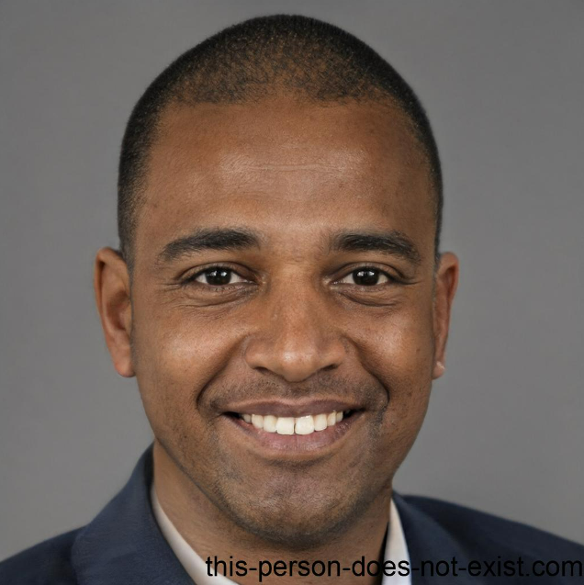
“R”
Goals
T
Frustrations
T
John Morgan
Age:
Education:
Hometown:
Family:
Occupation:
35
Bachelor
Adelaide
Single father of a son
Developer
B
Notes:
disabled，gay

